Slide 1


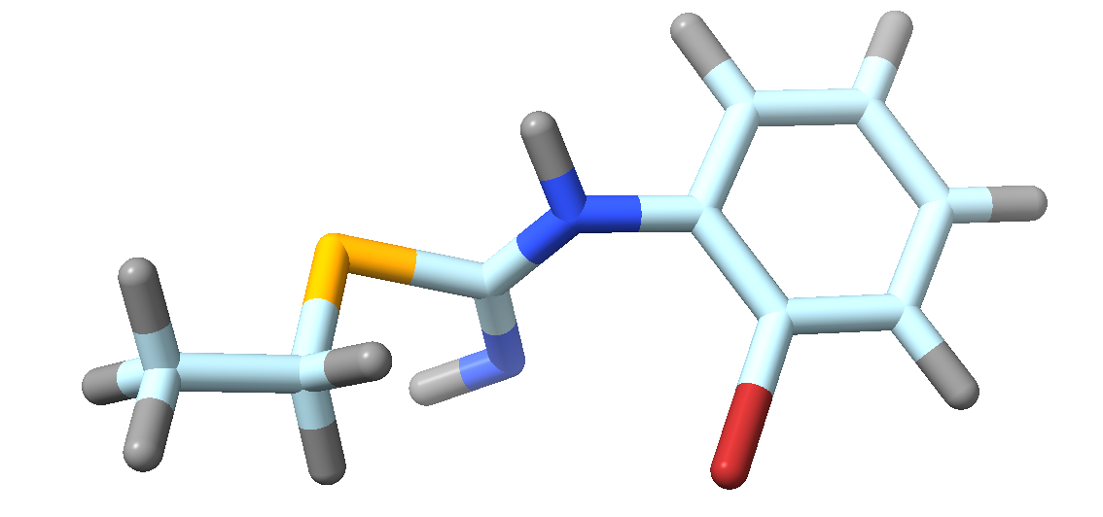
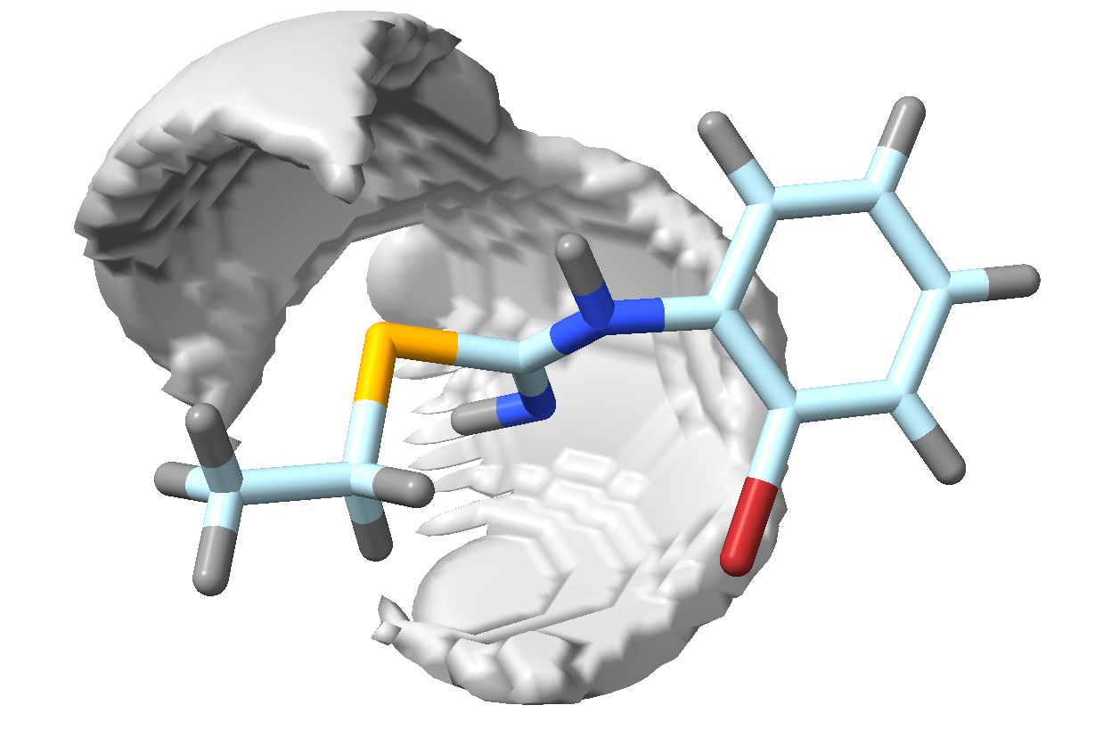
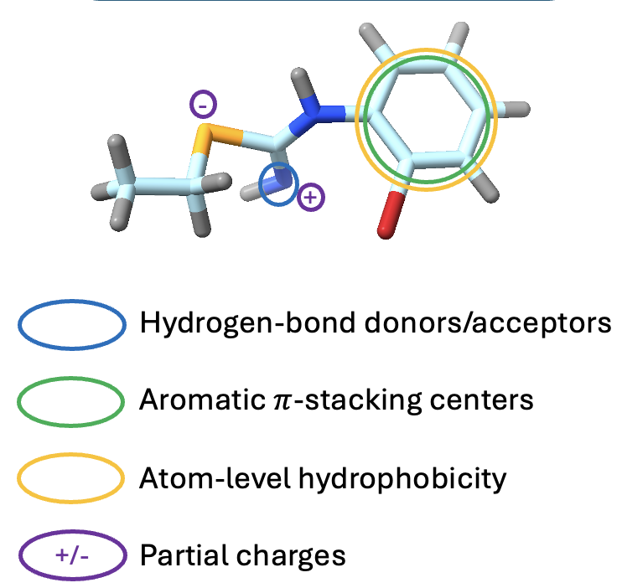
1. Data Collection
Extract molecular structures as SMILES from ChEMBL database
2. Data Filtering
Retain single organic drug-like molecules with ≤34 heavy atoms
3. 3D Conformer Generation
Convert SMILES structures to 3D conformations
SMILES: CCSC(=N)Nc1ccccc1Br
6. SMIF Generation
Generate SMIFs using SMIFFer framework to encode 3D interaction fields
5. Standardize Molecules
Translate molecules to their center of mass and align along principal axes to remove variations in spatial orientatin
4. Feature Extraction
Compute physiochemical features relevant to RNA-ligand interactions
SMIFS
(.chem)
Molecular Structures (.pdb)
Machine Learning Model Training Dataset

